Slide 1
Acquiring Data
Data Science for Beginners, Session 3
Notes:
Today we’re looking at the types of data that are hiding online, and how to bring them out of hiding and into your data science code.

Slide 2
Session 3: your 5-7 things
Finding development data
Data filetypes
Using an API
PDF scrapers
Web Scrapers
Getting data ready for science
Notes:
So let’s begin. Here are the 6 things we’ll talk about today.

Slide 3
Finding development data
Notes:
Your first problem is finding the data to help answer your questions.

Slide 4
Data
Data files (CSV, Excel, Json, Xml...)
Databases (sqlite, mysql, oracle, postgresql...)
APIs
Report tables (tables on websites, in pdf reports...)
Text (reports and other documents…)
Maps and GIS data (openstreetmap, shapefiles, NASA earth images...)
Images (satellite images, drone footage, pictures, videos…)
Social media (twitter, facebook, instagram, youtube...)
People (formal surveys, phone surveys, asking questions)
...
Notes:
A quick recap: these are some of the places where you can find data. Some of them are harder to process than others, but they all contain data.

Slide 5
Data Sources
data warehouses and catalogues
open government data
NGO websites
web searches
online documents, images, maps etc
people you know who might have data
Notes:
And here are some places to find them - there’s a longer list in the references folder.

Slide 6
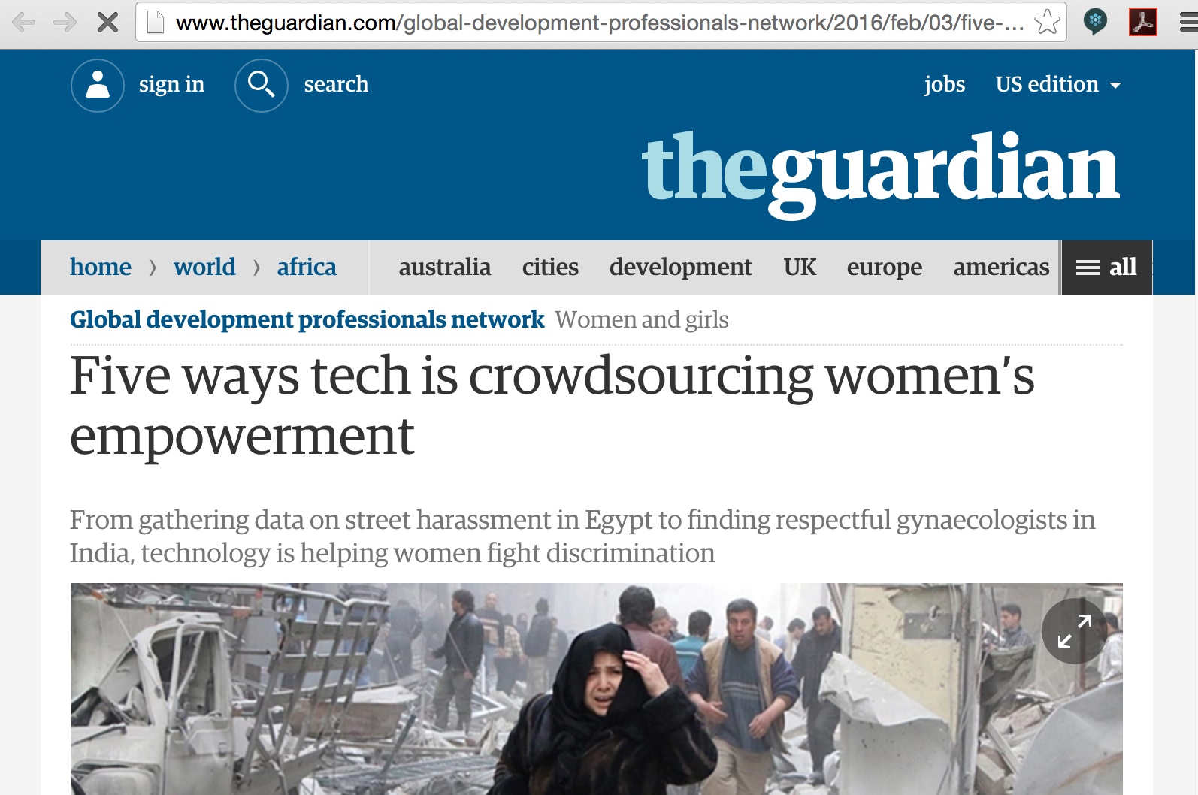
Creating your own data: People
Notes:
Development data isn’t always easy to obtain: you might have to create your own, by asking people to contribute information to you through crowdsourcing, in-person surveys, mobile surveys etc.

Slide 7
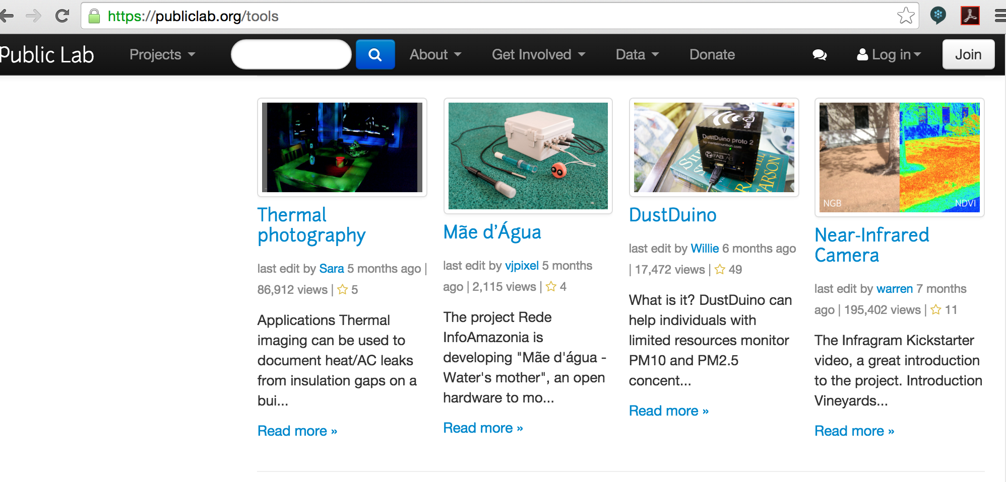
Creating your own data: Sensors
Notes:
You might also need to generate data for your problem by using sensors.

Slide 8
Be cynical about your data
Is the data relevant to your problem?
Where did this data come from?
Who collected it?
Why? What for?
Do they have biases that might show up in the data?
Are there holes in the data (demographic, geographical, political etc)?
Do you have supporting data? Is it *really* from a different source?
Can you use this data (are there privacy or copyright issues with using it)?
Notes:
Selection bias = non-random selection of individuals. One example of this is pothole reporting: potholes are more generally reported in more-affluent areas, by people who have both the smartphone apps and the time and energy to report.
Missing data = data that you don’t have. You need to be aware of this, and take account of it. If you need more persuading, read about Wald and the bullethole problem.

Slide 9
Data filetypes
Notes:
There are many datafile types - here’s a guide to some of them.

Slide 10
Some Data Types
Structured data:
Tables (e.g. CSVs, Excel tables)
Relational data (e.g. json, xml, sqlite)
Unstructured data:
Free-text (e.g. Tweets, webpages etc)
Maps and images:
Vector data (e.g. shapefiles)
Raster data (e.g geotiffs)
Images
Notes:
Tables typically have rows and columns; relational data is typically hierarchical, e.g. can’t be easily converted into row-column form.

Slide 11
CSVs
Comma-separated values
Lots of commas
Sometimes tab-separated (TSVs)
Most applications read CSVs
Notes:
CSVs are the workhorse of datatypes: almost every data application can read them in.

Slide 12
Json
JavaScript Object Notation
Lots of braces { }
Structured, i.e. not always row-by-column
Many APIs output JSON
Not all applications read JSON
Notes:
Converting JSON to CSV:
Use a conversion website (e.g. http://www.convertcsv.com/json-to-csv.htm)
Write some Python code

Slide 13
XML
eXtensible Markup Language
Lots of brackets < >
Structured, i.e. not always row-by-column
Some applications read XML
HTML is a form of XML
Notes:
Converting XML to CSV:
Use a conversion website, e.g. http://www.convertcsv.com/xml-to-csv.htm
Write code

Slide 14
Using an API
Notes:
One way to obtain data is through an application programming interface (API).

Slide 15
APIs
“Application Programming Interface”
A way for one computer application to ask another one for a service
Usually “give me this data”
Sometimes “add this to your datasets”
Notes:
More about open APIs: https://en.wikipedia.org/wiki/Open_API

Slide 16
RESTful APIs
http://api.worldbank.org/countries/all/indicators/SP.RUR.TOTL.ZS?date=2000:2015&format=csv
Base URL: api.worldbank.org
What you’re asking for: countries/all/indicators/SP.RUR.TOTL.ZA
Details: date=2000:2015, format=csv
Notes:
REST = Representational State Transfer; a human-readable way to ask APIs for information.
At the top is a RESTful URL (web address); you can type this directly into an internet browser to get a datafile. This address has 3 parts to it:
The base url, api.worldbank.org
a description of what you’re looking for - in this case, the total rural population for all countries in the world
Some more details, including filters (only data between 2000 and 2015) and data formats.
Try this address, and try “&format=json” instead of “&format=csv” at the end.

Slide 17
Using CURL on the command-line
curl -X GET <URL>
Notes:
REST = Representational State Transfer; a human-readable way to ask APIs for information.
At the top is a RESTful URL (web address); you can type this directly into an internet browser to get a datafile. This address has 3 parts to it:
The base url, api.worldbank.org
a description of what you’re looking for - in this case, the total rural population for all countries in the world
Some more details, including filters (only data between 2000 and 2015) and data formats.
Try this address, and try “&format=json” instead of “&format=csv” at the end.

Slide 18
Do this: try these URLs
http://api.worldbank.org/countries/all/indicators/SP.RUR.TOTL.ZS?date=2000:2015&format=csv
http://api.worldbank.org/countries/all/indicators/SP.RUR.TOTL.ZS?date=2000:2015&format=json
http://api.worldbank.org/countries/all/indicators/SP.RUR.TOTL.ZS?date=2000:2015&format=xml

Slide 19
the Python Requests library
import requests
import json
worldbank_url = "http://api.worldbank.org/countries/all/indicators/SP.RUR.TOTL.ZS?date=2000:2015&format=json"
r = requests.get(worldbank_url)
jsondata = json.loads(r.text)
print(jsondata[1])
Notes:
The Python requests library is useful for calling APIs from a python program (e.g. so you can then use or save the information returned from them). If anything goes wrong, try r.status_code
You’re maybe wondering how to get this json data into a file. Here’s the code for that:
import json
fout = open('mynewdata.json', 'w')
json.dump(jsondata, fout)

Slide 20
Request errors
r.status_code =
200: okay
400: bad request
401: unauthorised
404: page not found
Notes:
See https://www.w3.org/Protocols/rfc2616/rfc2616-sec10.html

Slide 21
Requests with a password
import requests
r = requests.get('https://api.github.com/user', auth=('yourgithubname', ‘yourgithubpassword'))
dataset = r.text

Slide 22
PDF Scrapers

Slide 23
Scraping
Data in files and webpages that’s easy for humans to read, but difficult for machines
Don’t scrape unless you have to
Small dataset: type it in!
Larger dataset: Look for datasets and APIs online
Notes:
Here are places to look first:
the website that data’s in, for file copies of the data
the website that data’s in, for an api (http://api.theirsitename.com/, http://theirsitename.com/api, Google “site:theirsitename.com api”)
related sites for file copies and apis
Community warehouses (scraperwiki.com, datahub.io etc.) for other peoples’ scrapers

Slide 24
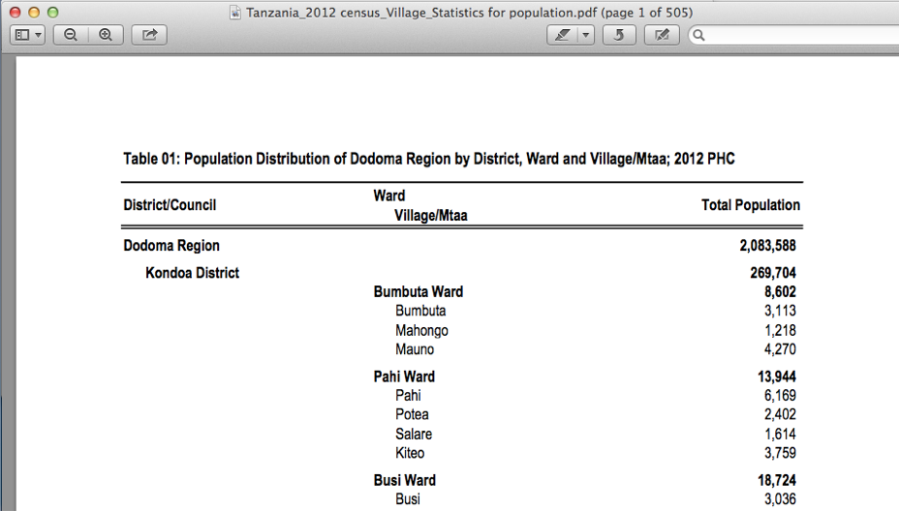
Development data is often in PDFs
Notes:
Big PDFs. And we’ll need to get the data out of them. This is where PDF scrapers come in.

Slide 25
Some PDFs can be Scraped
Open the PDF file in Acrobat
Can you cut-and-paste text in the file?
Y:
use a PDF scraper
N:
You could try OCR (Optical Character Recognition)
But you’ll probably have to type text in, or TurkSource

Slide 26
PDF Table Scrapers
Cut and paste to Excel
Tabula: free, open source, offline
Pdftables: not free, online
CometDocs: free, online

Slide 27
Web Scrapers

Slide 28
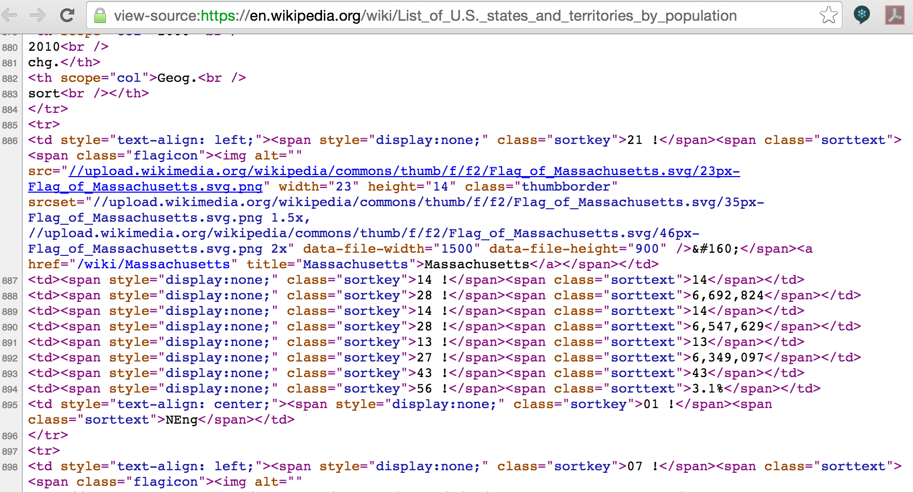
Web Scraping
Notes:
Web scraping is the process of extracting data from webpages.
If you open a webpage (e.g. https://en.wikipedia.org/wiki/List_of_U.S._states_and_territories_by_population) and click on “view source”, you’ll see the view that a computer has of that page. This is where the data is hiding…

Slide 29
Design First!
What do you need to scrape?
Which data values
From which formats (html table, excel, pdf etc)
Do you need to maintain this?
Is dataset regularly updated, or is once enough?
How will you make updated data available to other people?
Who could edit your code next year (if needed)?

Slide 30
Using Google Spreadsheets
Open a google spreadsheet
Put this into cell A1:
=importHtml("http://en.wikipedia.org/wiki/List_of_U.S._states_and_territories_by_population", "table", 2)
Notes:
The pattern for this is:
=importHtml(“your-weburl”, “table”, yourtablenumber)
More: www.mulinblog.com/basic-web-scraping-data-visualization-using-google-spreadsheets/

Slide 31
Web scraping in Python
Webpage-grabbing libraries:
requests
mechanize
cookielib
Element-finding libraries:
beautifulsoup
lxml.html
cssselect
Notes:
You’ve already used the Requests library to grab data from the web. Mechanise and Cookielib

Slide 32
Unpicking HTML with Python
url = "https://en.wikipedia.org/wiki/List_of_U.S._states_and_territories_by_population”
import requests
from bs4 import BeautifulSoup
html = requests.get(url)
bsObj = BeautifulSoup(html.text)
tables = bsObj.find_all('table’)
tables[0].find("th")

Slide 33
Getting data ready for science
Notes:
Your exercises were all built into the class. But if you want more…

Slide 34
Changing Data Formats
Conversion websites
Code:
import pandas as pd
df = pd.read_json(“myfilename1.json”)
df.write_csv(“myfilename2.csv”)
Notes:
Most data science and visualisation programs can read CSV data, so if you can easily convert data to that, good. There are websites that will convert to csv; you can also do this by reading data in one format, and writing it out in another.
The Pandas library is very helpful for reading in one format, and writing in another, if the data is row-column.

Slide 35
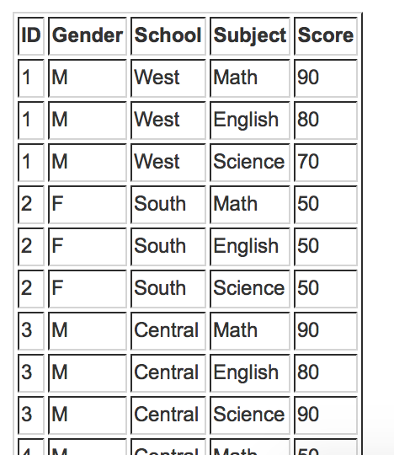
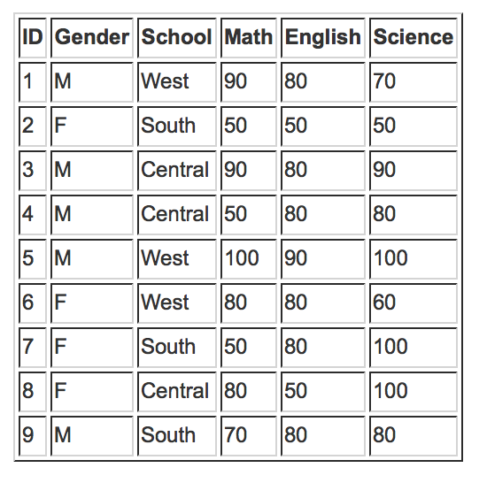
Normalising data
Notes:
We’ll cover data cleaning later, but if you want to try next week’s visualisation techniques on your own data, it will need to at least be normalised. Here’s what we mean by this (and Tableau has a tool for doing this: see http://kb.tableau.com/articles/knowledgebase/denormalize-data).

Slide 36
Books
"Web Scraping with Python: Collecting Data from the Modern Web", O'Reilly
Notes:
Most data science and visualisation programs can read CSV data, so if you can easily convert data to that, good. There are websites that will convert to csv; you can also do this by reading data in one format, and writing it out in another.
The Pandas library is very helpful for reading in one format, and writing in another, if the data is row-column.

Slide 37
Exercises
Notes:
Your exercises were all built into the class. But if you want more…

Slide 38
Prepare for next week
Install Tableau
See install instructions file

Slide 39
Prepare data
Use your problem statement to look for datasets - what do you need to answer your questions?
If you can, convert your data into normalised CSV files
Think about your data gaps - how can you fill them?

